Slide 1
How to Compare Technology Platforms
An Introduction to Requirements Gathering & Vendor Research for Nonprofits

Slide 2
Legal Disclaimer
The information included herein should never be used as a substitute for an organization’s technical and/or operational judgment and does not represent an official position of JPMorgan Chase Bank, N.A. or its affiliates. This information is provided on an "as is" basis without warranty of any kind, express or implied.

Slide 3
Objective
Provide some guidance on how to effectively evaluate technology platforms, applications, and systems to ensure your organization can adequately shift to conducting business in a virtual fashion.

Slide 4
What is Requirements Gathering?
At its core, requirements gathering is the process of understanding what you would like built and why, including the specific features you and your stakeholders would like to see in the final solution.
Requirements allow you to communicate your vision to a vendor who can implement your vision.

Slide 5
Step 1: Review & Understand Your Current In-Person Model
What does your current in-person model look like? What components need to be virtualized?
Examples:
Fundraising event (Gala, Silent Auction, Race, etc.)
Client consultations
Classroom learning for students or constituents
Training for employees or volunteers
Conference or convention
Brainstorm what aspects of your in-person model could still work in a virtual model

Slide 6
Step 2: Key Questions to Review
There are 2 types of questions you should review and ask yourself.
i
General
Product

Slide 7
Step 2: Key General Questions
Who is your audience/user?
Who are your players and stakeholders?
What is your budget?
What do you want your audience to do?
Why is this important?
General
i

Slide 8
Step 2: Key Product Questions
Features & Functionality
Define your Must-haves vs. Nice-to-haves
Maintenance
Is maintenance needed, or does the system maintain itself?
What are the features/functionality you require?
If maintenance is needed, who in your company will do this and how?
Cost
Understand one-time vs. ongoing costs
Do you purchase with one-time payment?
Are there monthly and/or annual costs?
Technical Support
What is your technical skill background?
Does the product you are considering have extensive technical support?
Does the product you are considering have good documentation?
Scalability
Will the system grow/scale with your business growth?
Will the system last and work after this situation/crisis is over?
Timeline
What are your immediate and long-term needs?
Will you need to break up implementation of the product into multiple projects or phases?
Product

Slide 9
Step 3: Finalize Requirements and Create an RFP/Q
Based off of your answers to the general and product-related questions, you can now define the scope of the project and what your final product may look like before contacting vendors.
Request for Proposal or Quote (RFP/Q): A document outlining the scope and requirements you are seeking for your virtual technology solution to solicit vendors to provide you price quotes on using their product.
TIP 1: Some companies offer reduced pricing for nonprofits. It never hurts to ask!
TIP 2: See TechSoup’s RFP Library for examples of nonprofit RFP/Qs
RFQ for Learning Management System
Requirement (Must-Haves)
✓
Requirement 1: Mobile Friendly
Requirement 2: Low Cost
Requirement 3: Scalable
Nice-to-have: Push Notifications
✓
✓
✗

Slide 10
Step 4: Document Responses from Vendors
Use a matrix to help you document responses and quotes from vendors to select a final solution. The matrix can include:
Platform and Solution Types
Along the top of the table, list all the potential technology solutions that are viable options.
Features & Functionality
On the left side of the table, list the requirements / functionality your client is looking for, as part of their solution.
Assess Your Platform
Based on the functionality of each solution, verify whether the solution meets your needs by marking the box ‘Y/N’ and adding any comments where necessary (for example, why requirements are not met, workaround considerations, etc.)
Calculate the Total Cost of Ownership
Cost of ownership in terms of money and resources that you will incur for the solution such as the set-up costs and effort, deployment costs and effort, monthly maintenance fees, any fees associated with making updates, hosting fees, etc.

Slide 11
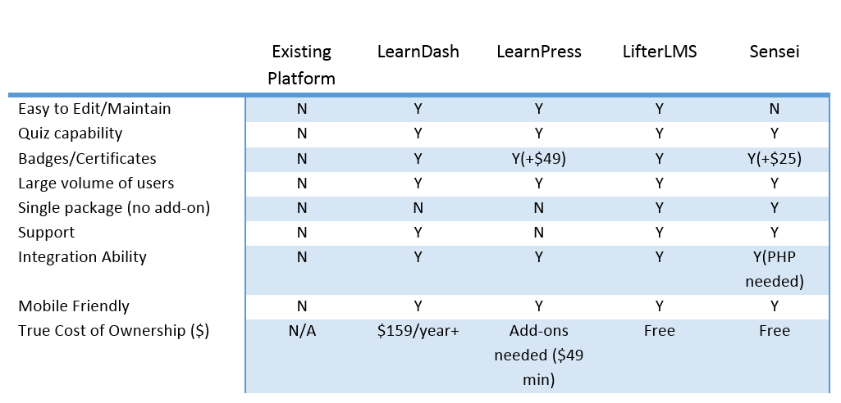
Example Vendor & Tool Comparison Matrix
Final
Solution
A nonprofit is looking to move all of their in-person volunteer training online. They specifically are looking for an online orientation and training system that will integrate into their existing web site. Some of their required features:
Easy to maintain and host text and video based training modules
Quiz capability upon completion of each training module
Ability to assign badges as incentives when volunteers complete training tracks
Query capabilities that allows for locating volunteers with specific training needed to fill roles
Potential integration with existing volunteer management system to avoid multiple user accounts

Slide 12
Questions?
Contact us at tech.for.social.good@jpmorgan.com

